Slide 1
VCNL4040
CENG317-Dylan Ashton

Slide 2
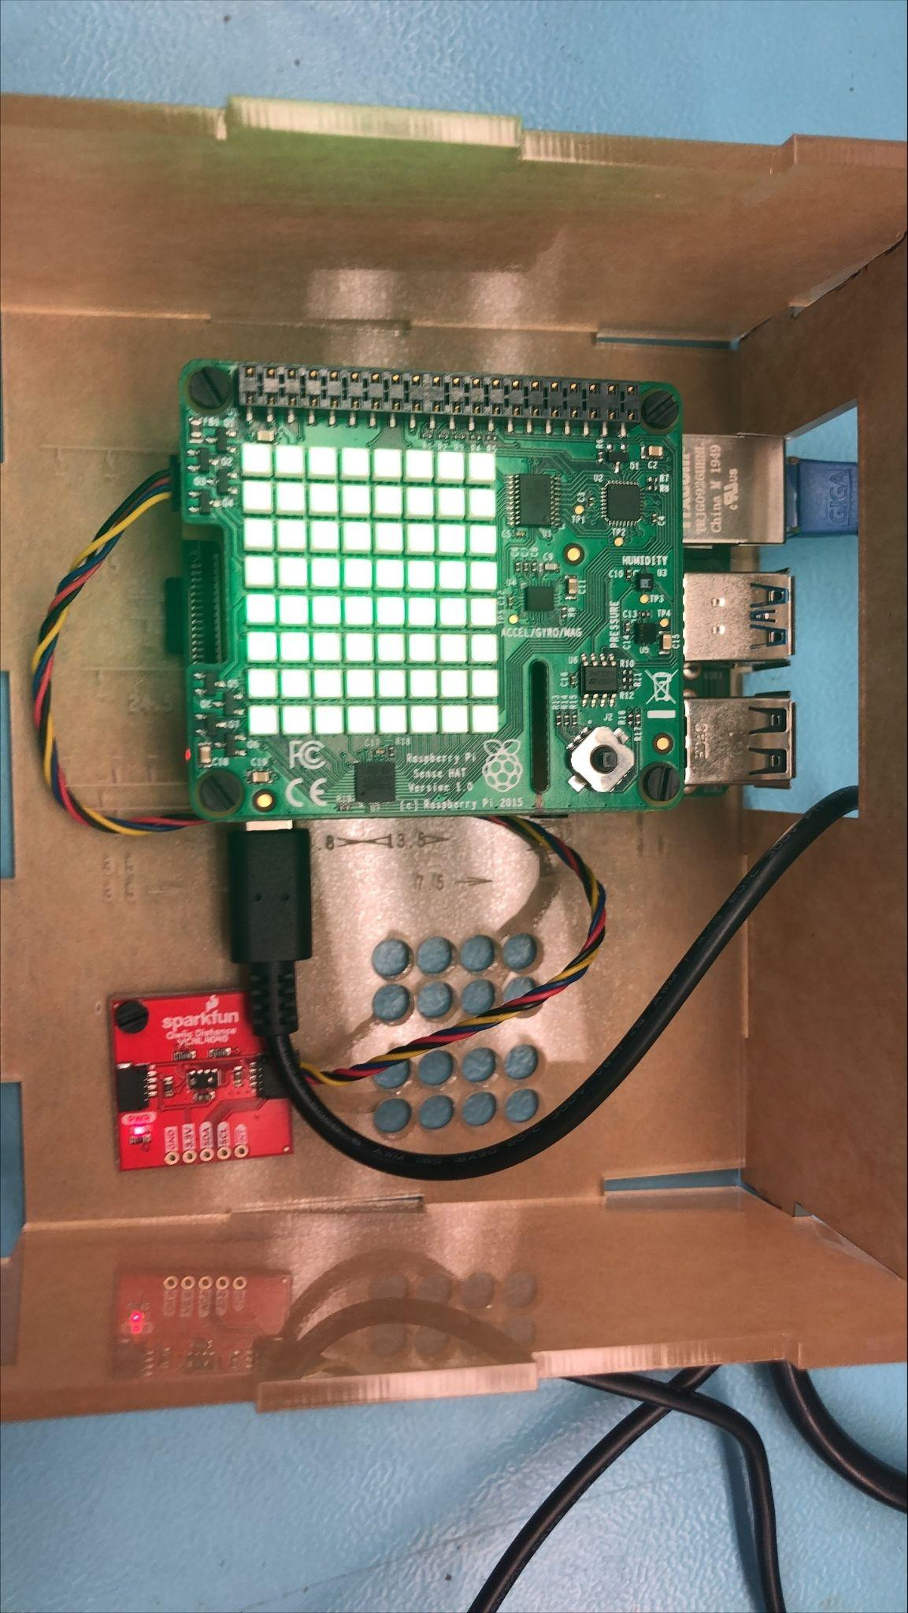
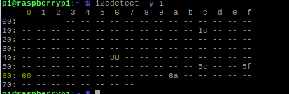
I2C address of the VCNL4040 is 0x60

Slide 3
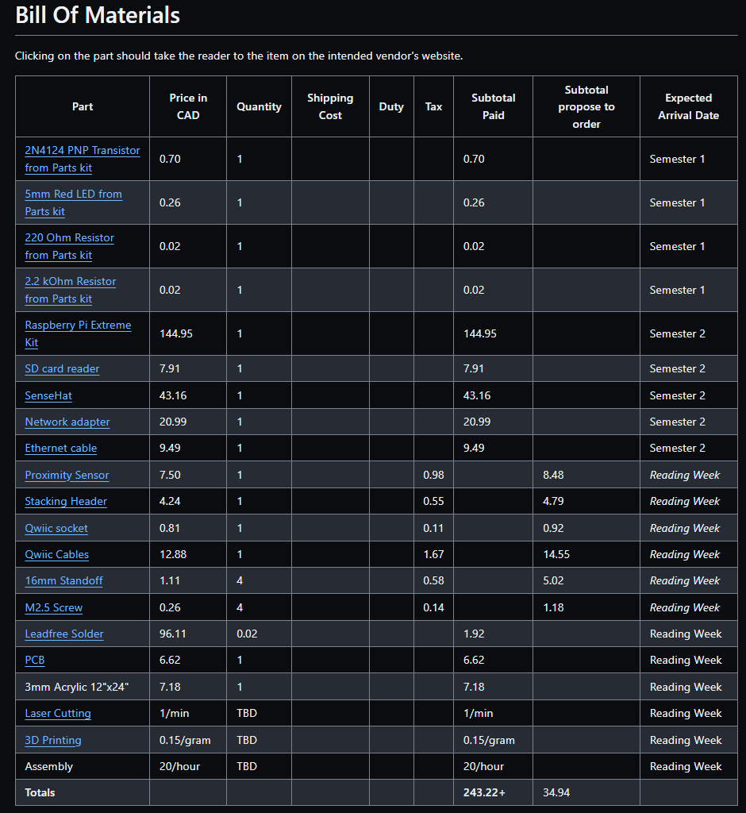

Slide 4
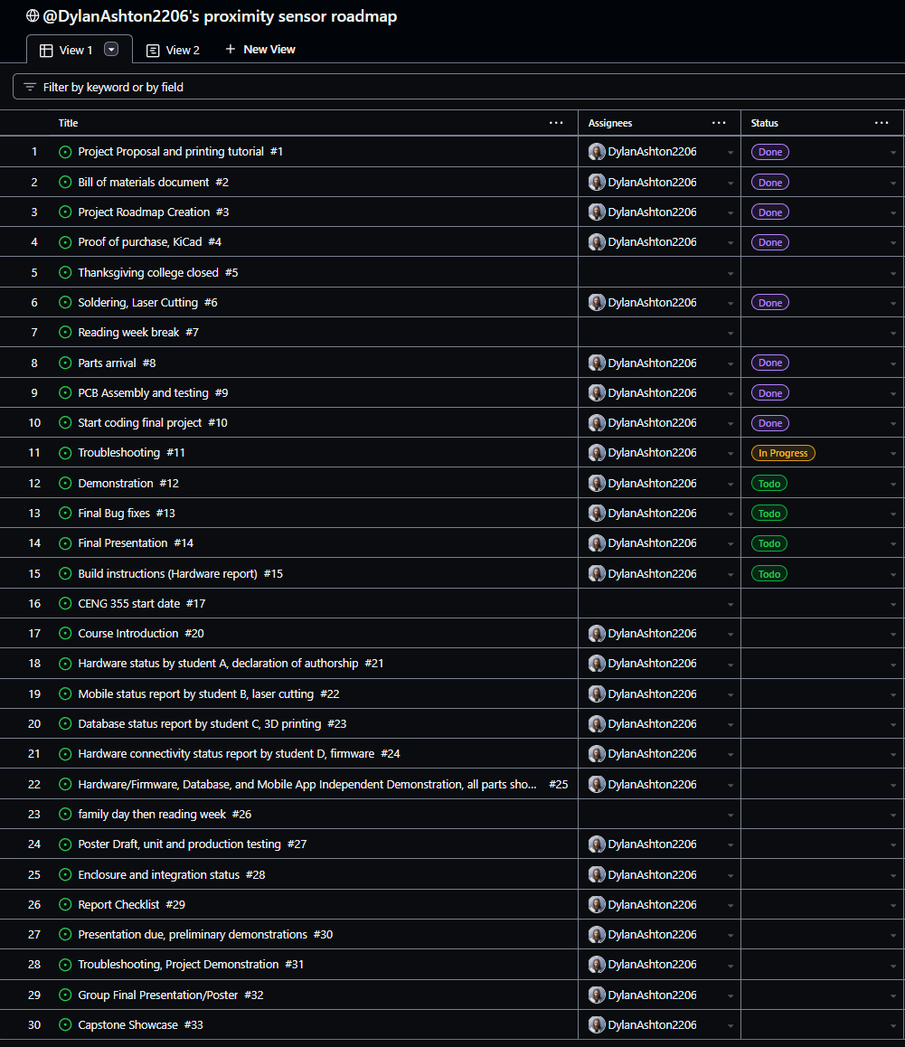

Slide 5
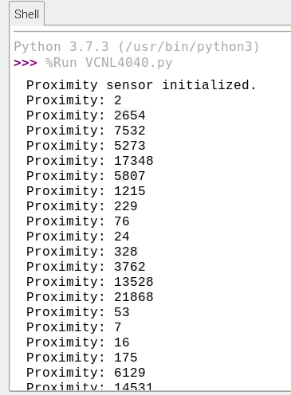
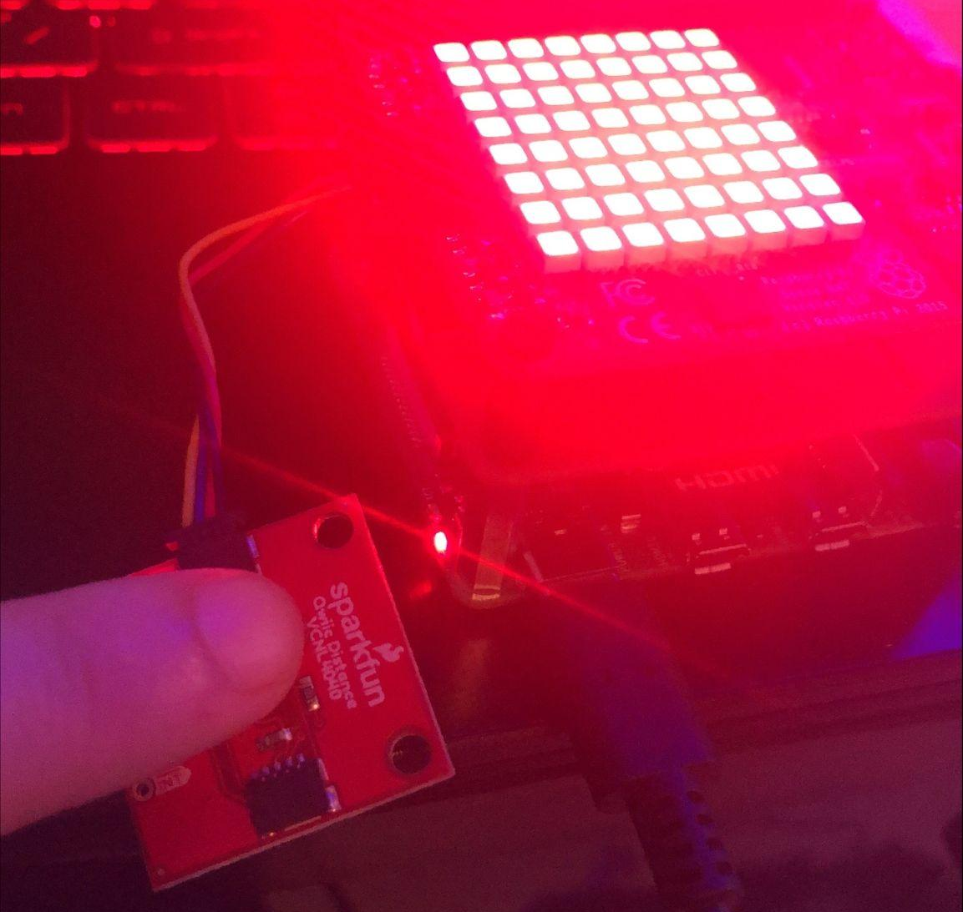
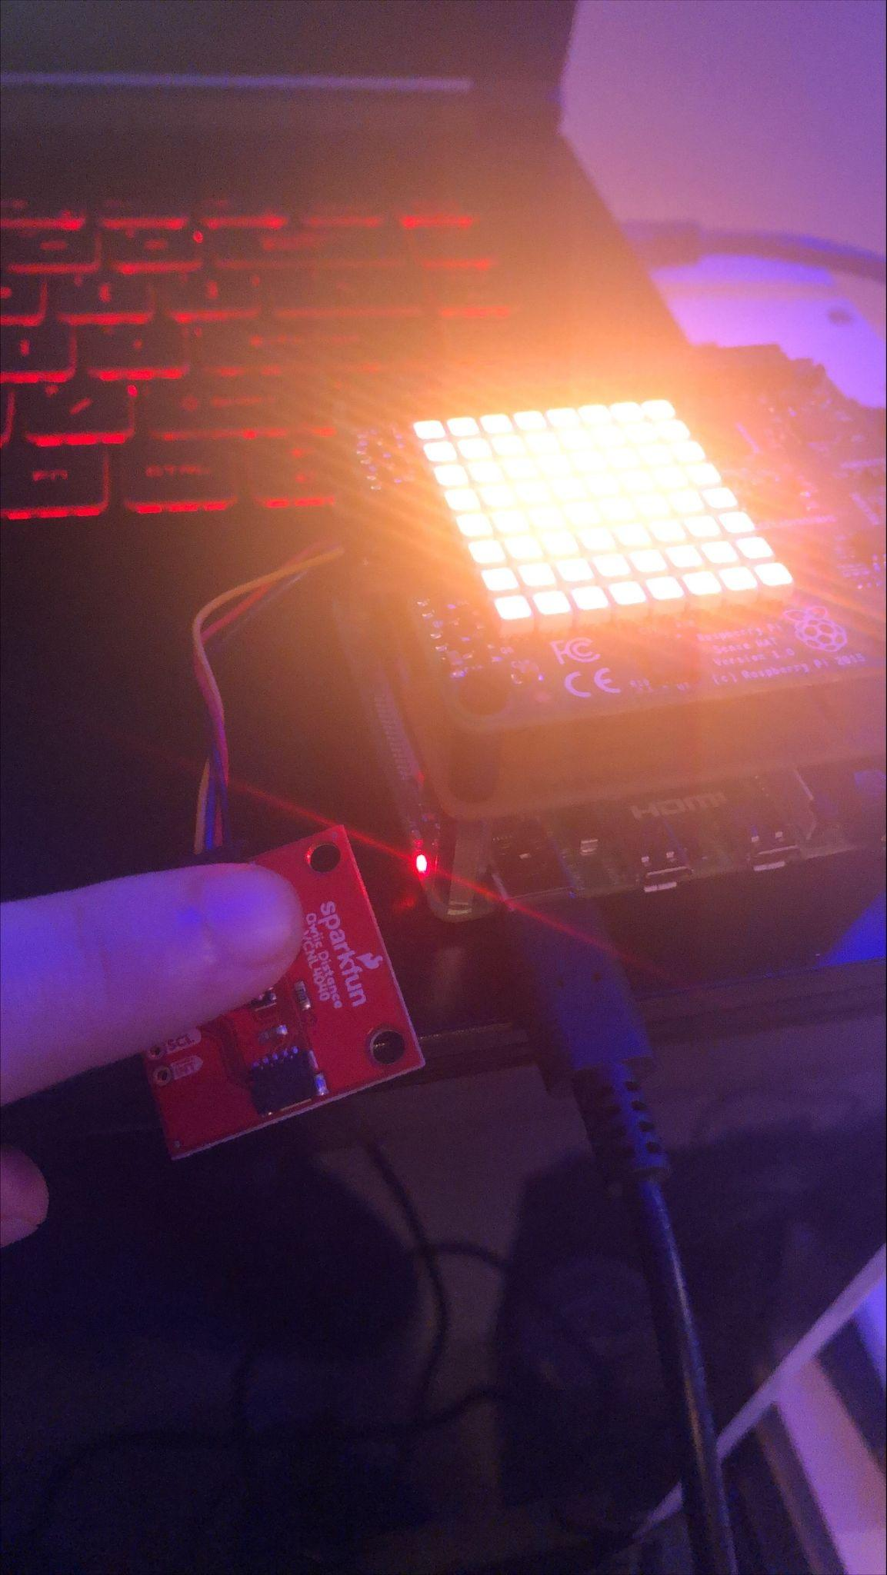
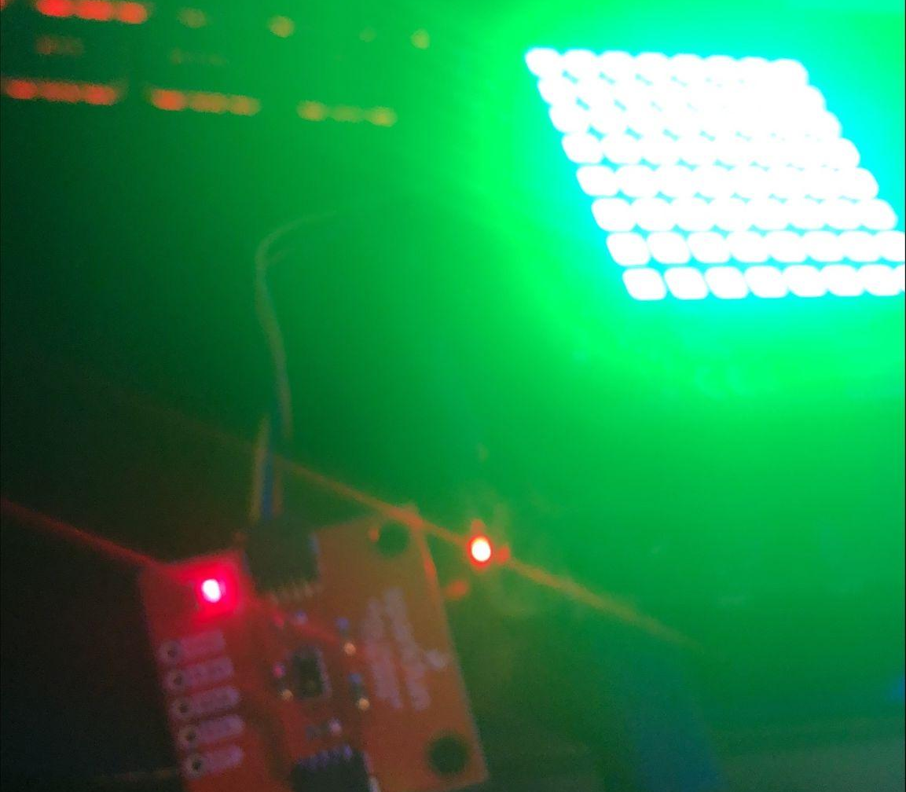
TOUCHING
SHORT PROXIMITY
Range=0-20cm
NO OBSTRUCTION

Slide 6
Course knowledge utilized from previous courses.
Electric Circuits: Learned electrical principles for connecting the Raspberry Pi and sensor.
Digital Fundamentals: Understood digital systems, key to Raspberry Pi operations.
Programming Fundamentals: Acquired basic programming skills for Python coding.
Computer Hardware & Operating Systems: Gained knowledge in hardware and operating systems, aiding Raspberry Pi setup.
Embedded Systems: Provided insights into integrating hardware and software, essential for Raspberry Pi sensor work.
Object Oriented Programming I & II: Enhanced understanding of programming concepts, applicable in Python.
UNIX Internals & Unix Scripting: Offered UNIX/Linux background, useful for Raspberry Pi’s environment.

